Slide 1
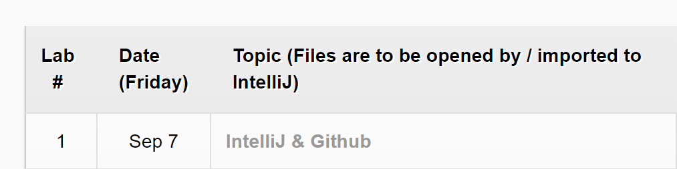
Notice:
Start your computer and login in using your CSD account
Download today’s lab material from Course Website
https://course.cse.ust.hk/comp3021/#labs
Lab 1 material: a readme file only

Slide 2
COMP3021 Java Programming
LAB 1

Slide 3
Content
Introduce of lab session
Get familiar with IntelliJ IDEA and JDK10
Create your first Java 10 program
Start to use git for version control

Slide 4
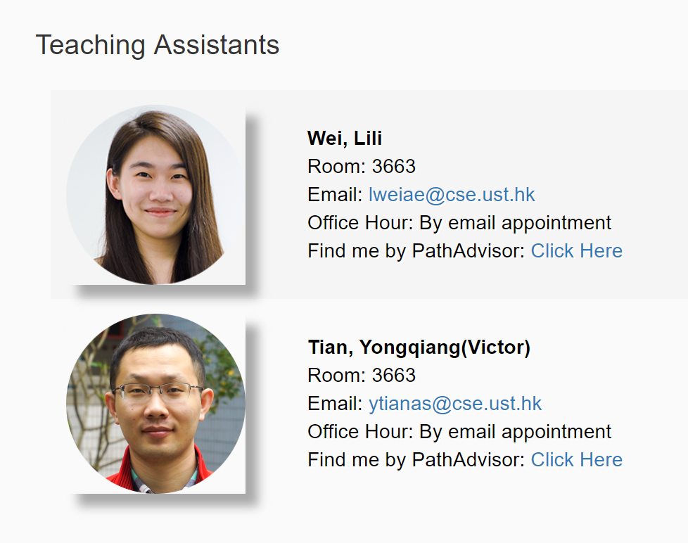
Introduction of COMP3021 Lab
Every Friday, 14:00-15:00
RM 4210
Two TAs will work with you.
Office hour by appointment.

Slide 5
Introduction of COMP3021 Lab
To get full points of lab session, you need:
Attend each session (1pt)
Finish all requirement and demo to us in the lab, or, submit the code/screenshot to CASS, by 23:59, next Thursday. (1pt)
If you attend the lab, you get 1pt, no matter your code works or not.
If you finish all requirements, you get 1pt, no matter you attend the lab or not.

Slide 6
Introduction of COMP3021 Lab
You can work with your lab in:
RM4210, all configuration is ready for you.
Virtual barn, ITSC has installed for us IntelliJ and JDK10
Remember to backup you data!
Your own PC, but you need configure IntelliJ and JDK10 by yourself

Slide 7
Lab 1:
Basic knowledge of IntelliJ, Java 10 and git

Slide 8
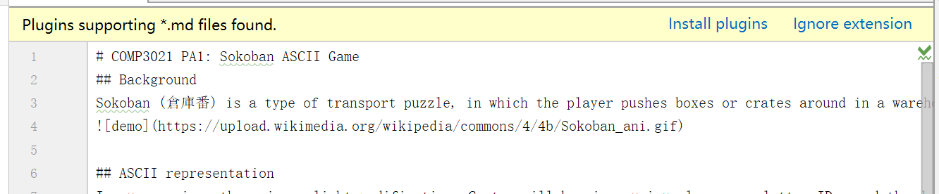
Open readme in IntelliJ
Download the readme file from course web page:
Open it using IntelliJ (Just Drag the file to IntelliJ)
IntelliJ may remind you to install .md plugin
Click Install and restart IntelliJ

Slide 9
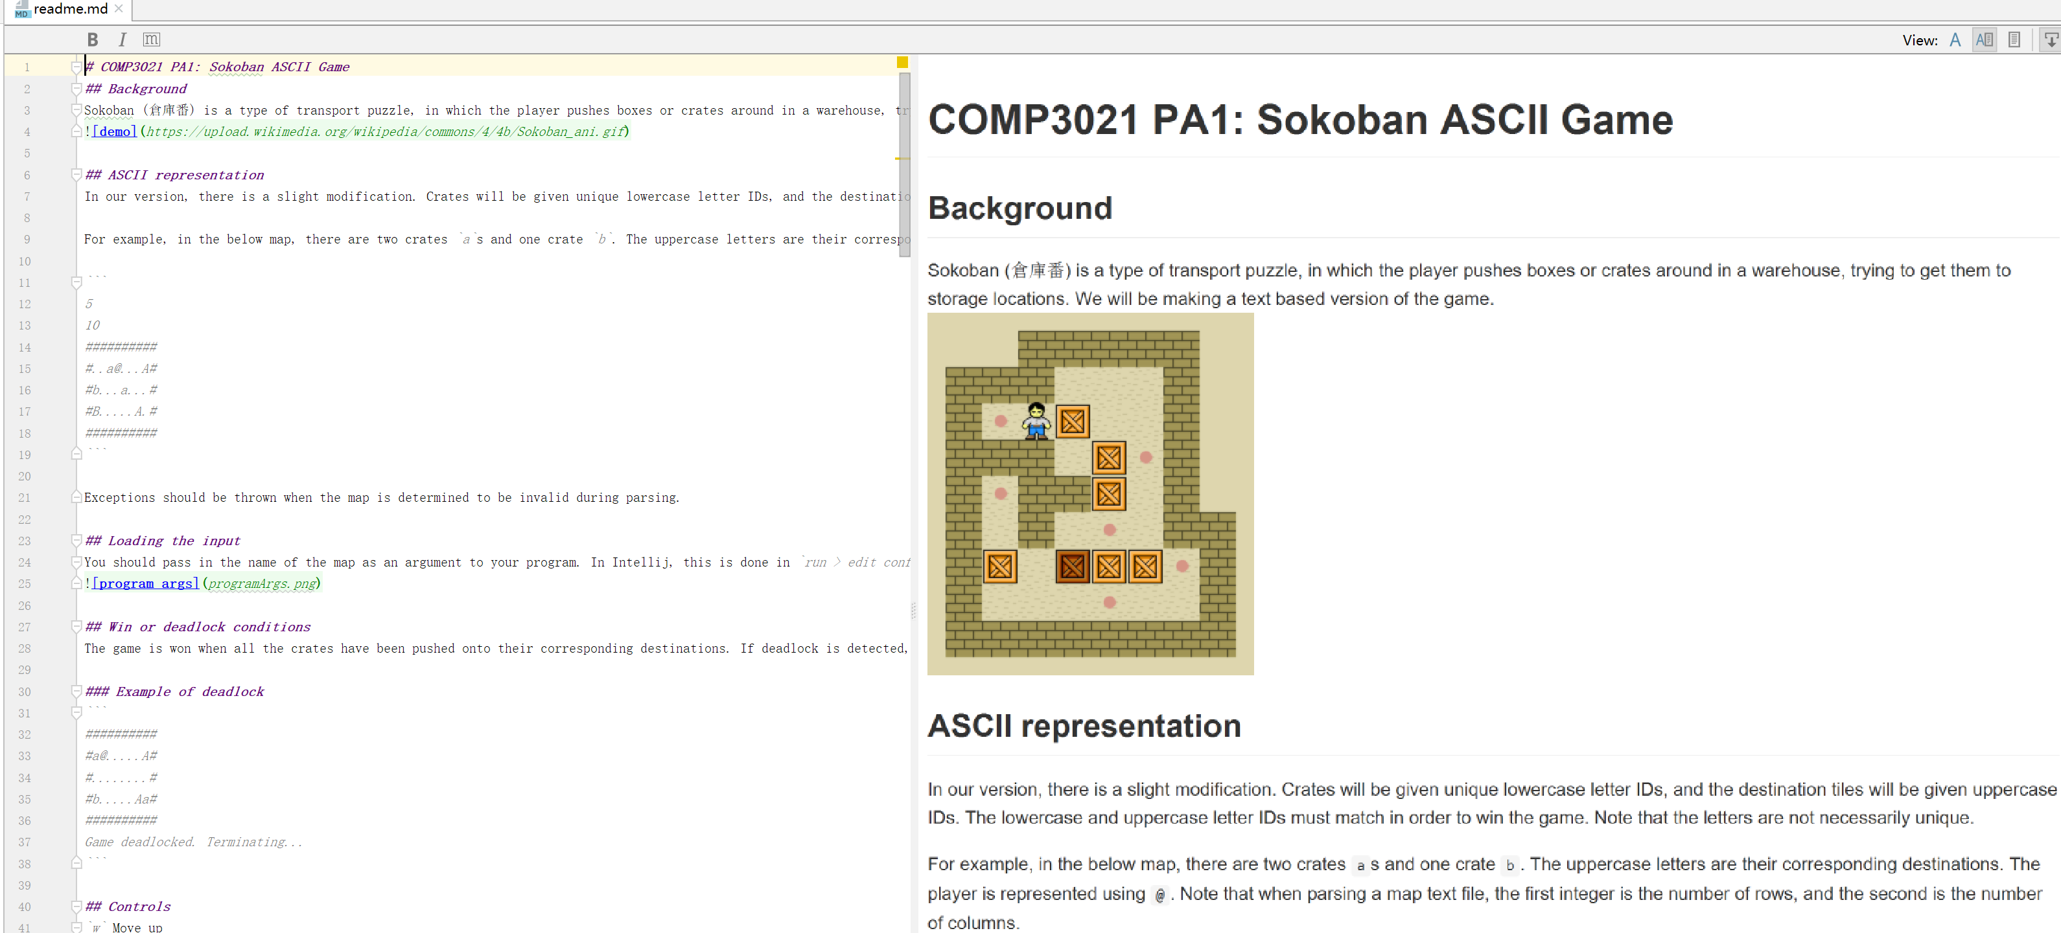

Slide 10
IntelliJ IDEA
A IDE for JAVA, similar with Eclipse
It has a lot plugins
Such as: markdown, git
We will use them later
It has two versions: Community(free) and Ultimate(not free)
With a student email account, you can use ultimate version free.
Either one is fine for this course

Slide 11
Demo
IntelliJ and its markdown plugin
Create a project using IntelliJ
Shortcuts

Slide 12
Demo
Import and export
https://youtu.be/58xRIW5D-Zo

Slide 13
Demo
Git
https://youtu.be/AuyA87IpHzQ

Slide 14
Lab 1 Outcome submission
1. Import our prepared assignment1.zip into IntelliJ
2. Create a git repository for your imported assignment 1 project
3. Create a private repository on GitHub
4. Add your GitHub repository as a remote repository for your imported assignment 1 project
5. Push your assignment 1 to your private repository on GitHub
6. Submit a Word or PDF file including a screenshot of your imported IntelliJ project and a screenshot of your created Git repository on GitHub to [CASS](https://course.cse.ust.hk/cass)

